Slide 1
Digital Fundamentals
CHAPTER 3
Logic Gates

Slide 2
Logic Gates
Inverter
AND Gate
OR Gate
Exclusive-OR Gate
NAND Gate
NOR Gate
Exclusive-NOR Gate
Notes:
Each of the two digits in the binary system, 1 and 0, is called a bit, which is a contraction
of the words binary digit.
A system in which a 1 is represented by a HIGH and a 0 is represented by a LOW is
called positive logic. system in which a 1 is represented by a LOW and a 0 is represented by a HIGH is
called negative logic.
Groups of bits (combinations of 1s and 0s), called codes, are used to represent numbers, letters, symbols, instructions, and anything else required in a given application.
The voltages used to represent a 1 and a 0 are called logic levels. Ideally, one voltage level represents a HIGH and another voltage level represents a LOW. In a practical digital circuit, however, a HIGH can be any voltage between a specified minimum value and a specified maximum value. Likewise, a LOW
Digital waveforms consist of voltage levels that are changing back and forth between the HIGH and LOW levels or states. A positive-going pulse is generated when the voltage (or current) goes from its normally LOW level to its HIGH level and then back to its LOW level. The negative-going pulse in Figure 1–7(b) is generated when the voltage goes from its normally HIGH level to its LOW level and back to its HIGH level.
The time required for a pulse to go from its LOW level to its HIGH level is called the
rise time (tr), and the time required for the transition from the HIGH level to the LOW level
is called the fall time (tf). In practice, it is common to measure rise time from 10% of the
pulse amplitude (height from baseline) to 90% of the pulse amplitude and to measure the
fall time from 90% to 10% of the pulse amplitude, as indicated in Figure 1–8. The bottom
10% and the top 10% of the pulse are not included in the rise and fall times because of
the nonlinearities in the waveform in these areas. The pulse width (tW) is a measure of the
duration of the pulse and is often defined as the time interval between the 50% points on
the rising and falling edges, as indicated in Figure 1–8.

Slide 3
The Inverter

Slide 4
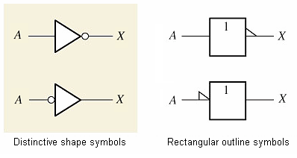

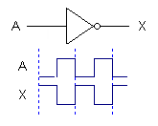
The Inverter
Truth table
0 = LOW
1 = HIGH
Boolean expression
Pulsed waveforms
The output of an inverter is always the complement (opposite) of the input.

Slide 5
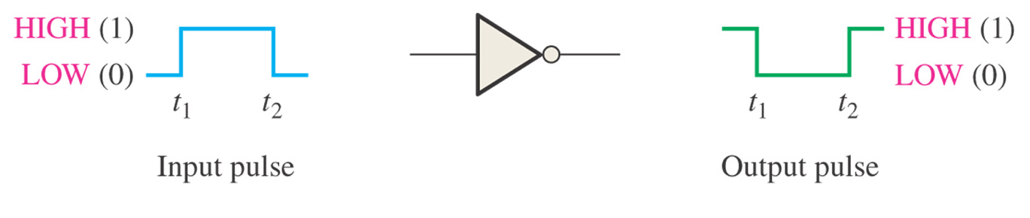
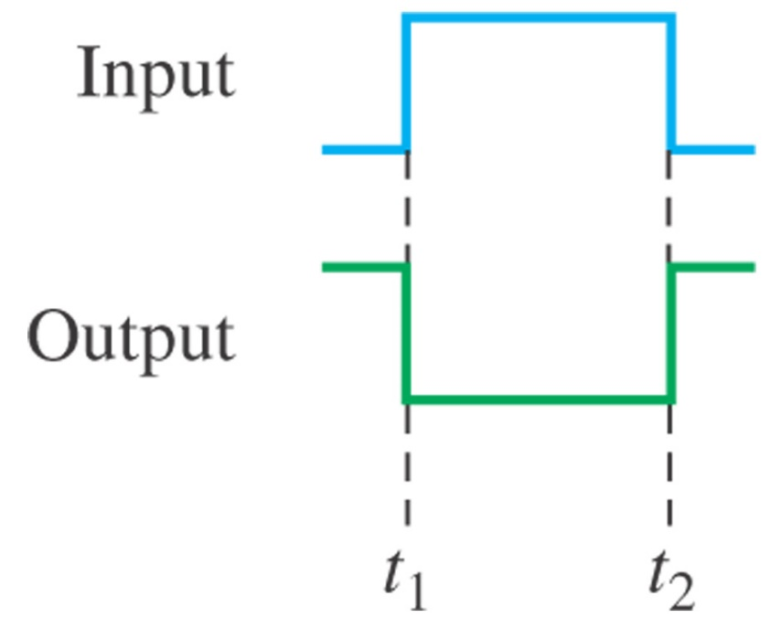
Figure 3–2 Inverter operation with a pulse input. Open file F03-02 to verify inverter operation.
Notes:
timing diagram is basically a graph that accurately displays
the relationship of two or more waveforms with respect to each other on a time basis.

Slide 6
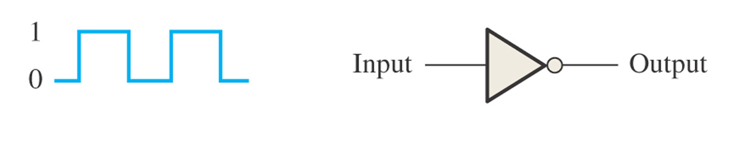
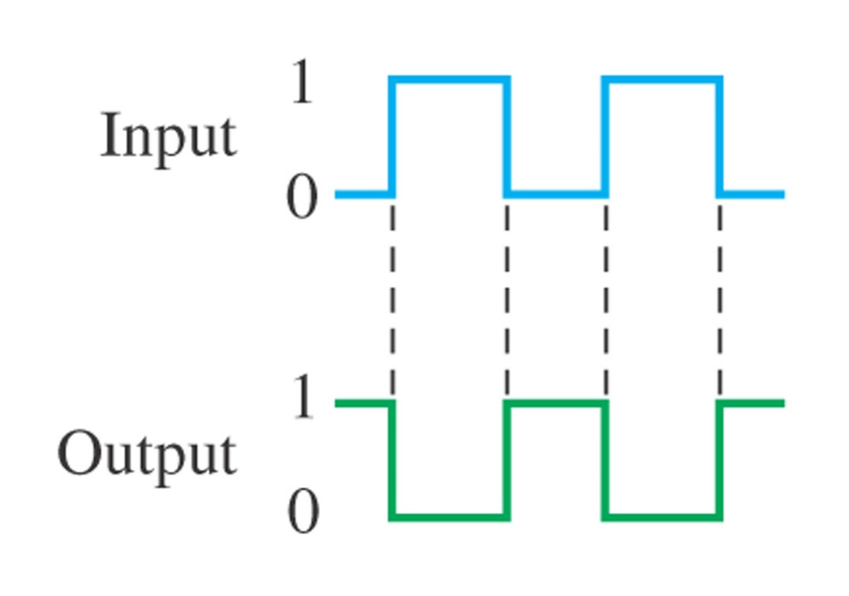
Figure 3–4
What is the output waveform?

Slide 7
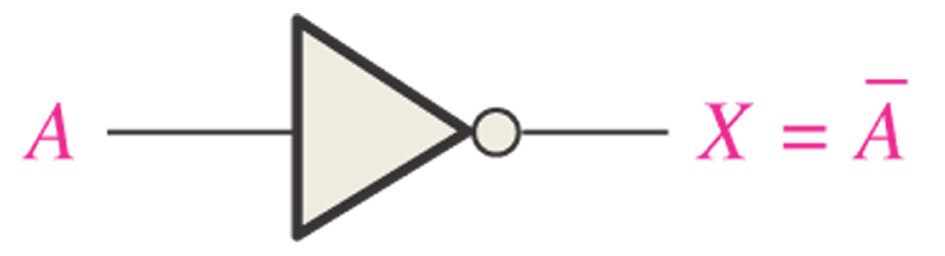
Figure 3–6 The inverter complements an input variable.
Notes:
a variable is generally designated by one or two letters although there
can be more. Letters near the beginning of the alphabet usually designate inputs, while letters
near the end of the alphabet usually designate outputs. The complement of a variable
is designated by a bar over the letter. A variable can take on a value of either 1 or 0. If a
given variable is 1, its complement is 0 and vice versa.
The operation of an inverter (NOT circuit) can be expressed as follows: If the input variable
is called A and the output variable is called X, then
X = A
This expression states that the output is the complement of the input, so if A = 0, then X = 1,
and if A = 1, then X = 0. Figure 3–6 illustrates this. The complemented variable A can
be read as “A bar” or “not A.”

Slide 8
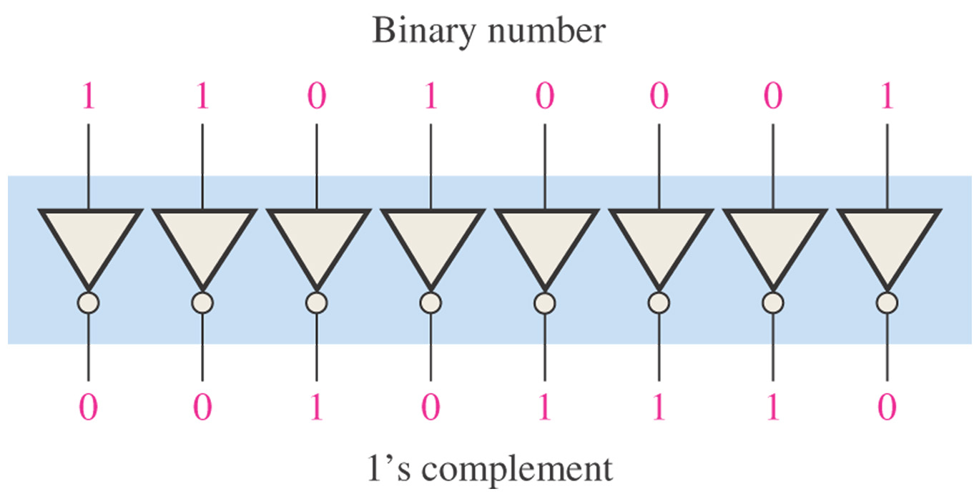
Figure 3–7 Example of a 1’s complement circuit using inverters.
Notes:
Figure 3–7 shows a circuit for producing the 1’s complement of an 8-bit binary number.

Slide 9
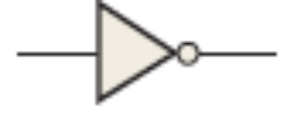
Secti on 3–1 Checkup
1. When a 1 is on the input of an inverter, what is the output?
2. An active-HIGH pulse (HIGH level when asserted, LOW level when not) is required on an inverter input.
(a) Draw the appropriate logic symbol, using the distinctive shape and the negation indicator, for the inverter in this application.
(b) Describe the output when a positive-going pulse is applied to the input of an inverter.
A negative-going pulse is on the output (HIGH to LOW and back HIGH).

Slide 10
The AND Gate

Slide 11
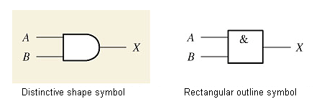

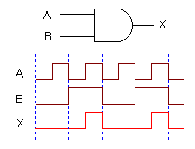
The AND Gate
Boolean expression
Truth table
0 = LOW
1 = HIGH
Same as Boolean multiplication
Pulsed waveforms
The output of an AND gate is HIGH only when all inputs are HIGH.

Slide 12
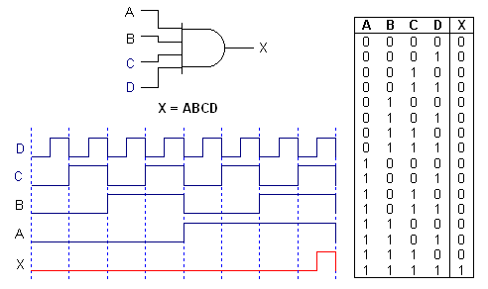
The AND Gate
4-Input AND Gate

Slide 13



Truth Tables
Total number of possible combinations of binary inputs
N = 2^{n}
For two input variables:
N = 2² = 4 combinations
For three input variables:
N = 2³ = 8 combinations
For four input variables:
N = 2⁴ = 16 combinations

Slide 14
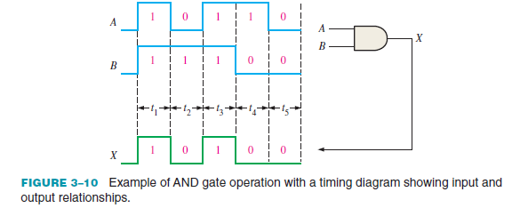

Slide 15
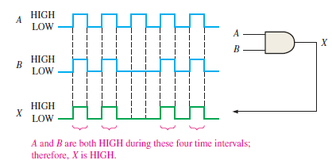
If two waveforms, A and B, are applied to the AND gate inputs as in Figure 3–11, what is the resulting output waveform?

Slide 16
If two waveforms, A and B, are applied to the AND gate inputs as in Figure 3–11, what is the resulting output waveform?

Slide 17
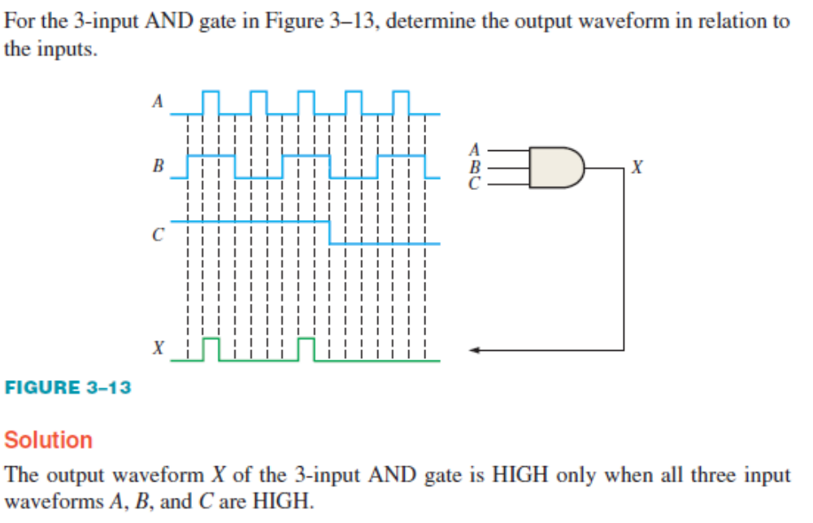

Slide 19
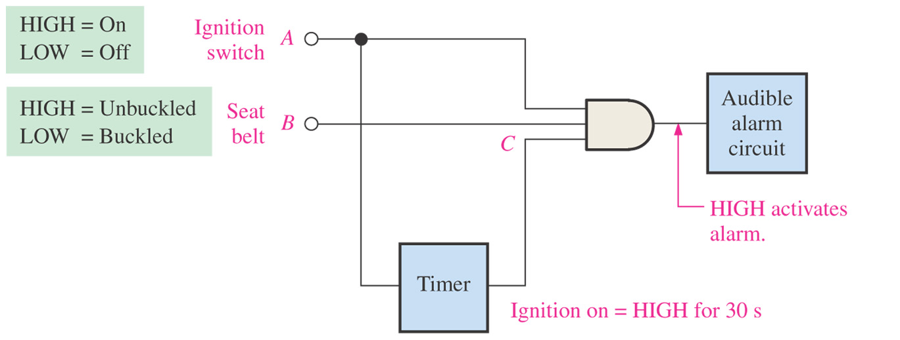
Figure 3–16 A simple seat belt alarm circuit using an AND gate.
If all three inputs are high, then the output is high and the alarm is activated.
If (Ignition switch = ON) AND (Seat belt = Unbuckled) AND (Timer = ON) then
Activate Alarm
End If

Slide 20
The OR Gate

Slide 21
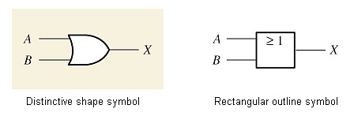

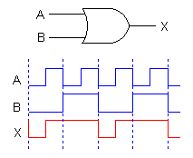
The OR Gate
Boolean expression
Truth table
0 = LOW
1 = HIGH
Same as Boolean addition, except no carry
Pulsed waveforms
The output of an OR gate is HIGH whenever one or more inputs are HIGH

Slide 22
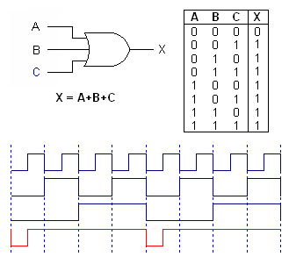
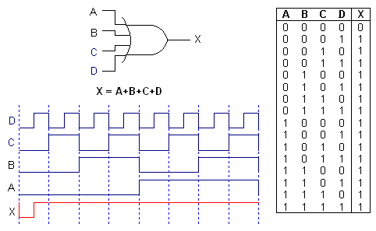
The OR Gate
3-Input OR Gate
4-Input OR Gate

Slide 23
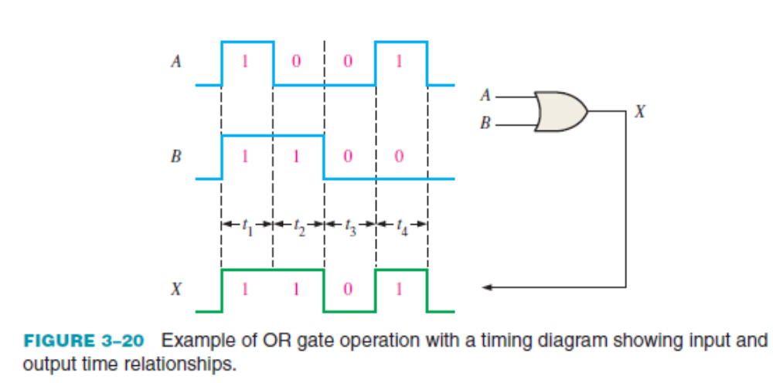

Slide 25
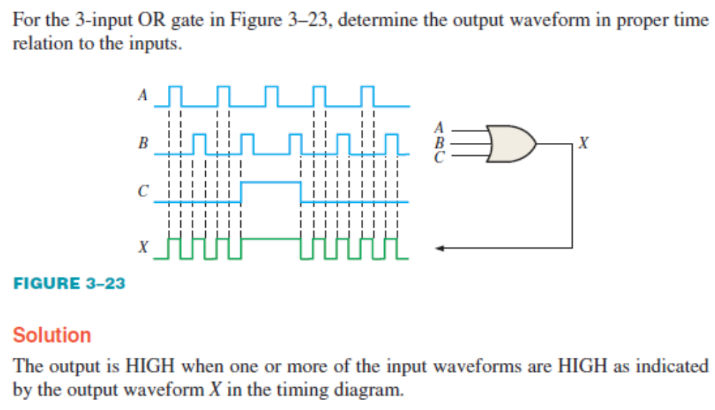

Slide 27
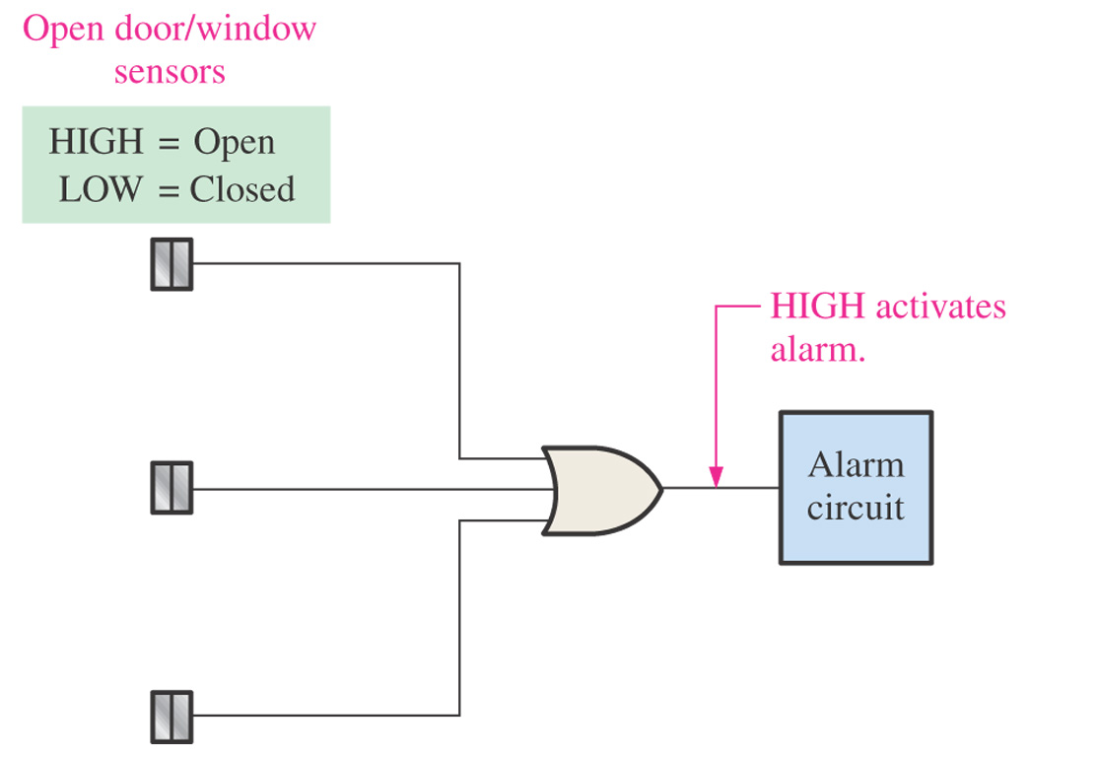
Figure 3–24 A simplified intrusion detection system using an OR gate.
Front Door
Back Door
Window
If any of the three inputs are high, then the output is high and the alarm is activated.
If (Front Door = Open) OR (Back Door = Open) OR (Window = Open) then
Activate Alarm
End If

Slide 28
Checkup
1. When is the output of an OR gate HIGH?
An OR gate output is HIGH when one or more inputs are HIGH.
2. When is the output of an OR gate LOW?
An OR gate output is LOW only when all inputs are LOW.
3. Describe the truth table for a 3-input OR gate.
Three-input OR: X = 0 when ABC = 000, and X = 1 for all other combinations of ABC.
A | B | C | X
0 | 0 | 0 | 0
0 | 0 | 1 | 1
0 | 1 | 0 | 1
0 | 1 | 1 | 1
1 | 0 | 0 | 1
1 | 0 | 1 | 1
1 | 1 | 0 | 1
1 | 1 | 0 | 1
1 | 1 | 1 | 1

Slide 29
The NAND Gate

Slide 30
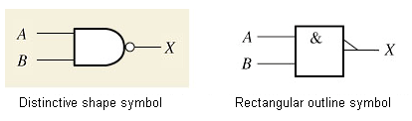

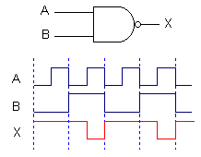

The NAND Gate
Boolean expression
Truth table
0 = LOW
1 = HIGH
Pulsed waveforms
The output of a NAND gate is HIGH whenever one or more inputs are LOW.

Slide 31
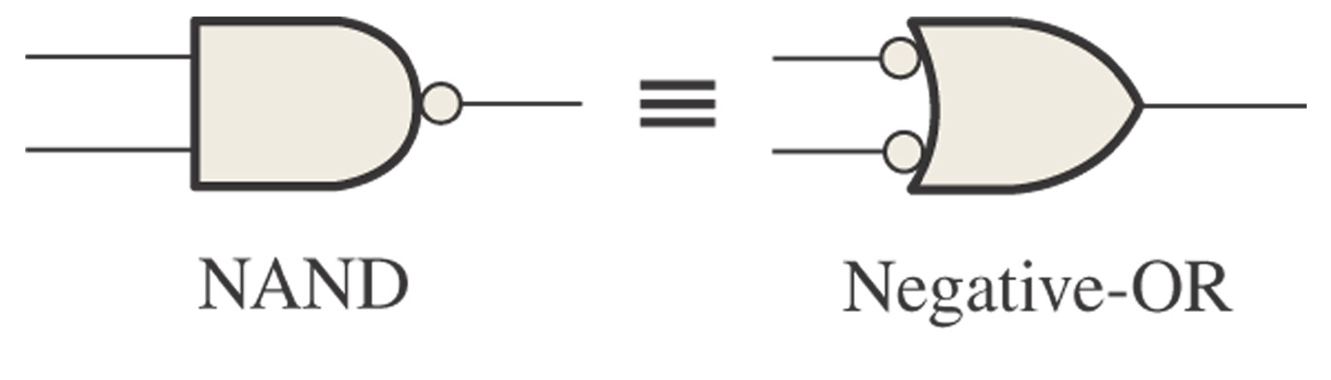
Figure 3–29
Standard symbols representing the two equivalent operations of a NAND gate.
X = AB = A + B
X = A + B = AB

Slide 32
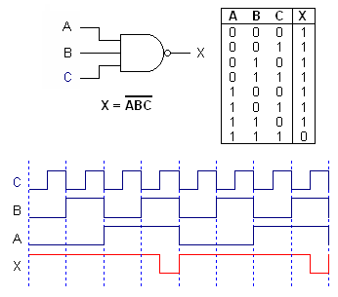
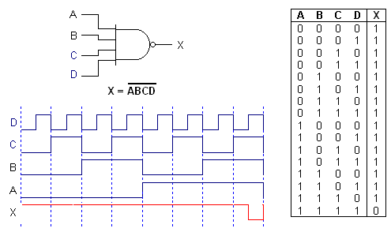
The NAND Gate
3-Input NAND Gate
4-Input NAND Gate

Slide 33
The NOR Gate

Slide 34
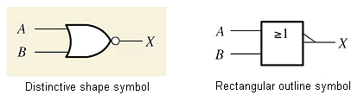


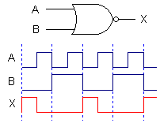
The NOR Gate
NOR is equivalent to NOT/OR
Boolean expression
Truth table
0 = LOW
1 = HIGH
Pulsed waveforms
The output of a NOR gate is LOW whenever one or more inputs are HIGH.

Slide 35
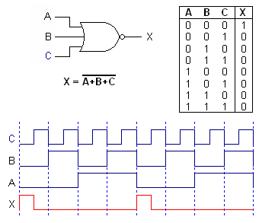
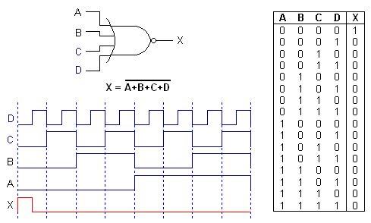
The NOR Gate
3-Input NOR Gate
4-Input NOR Gate

Slide 36
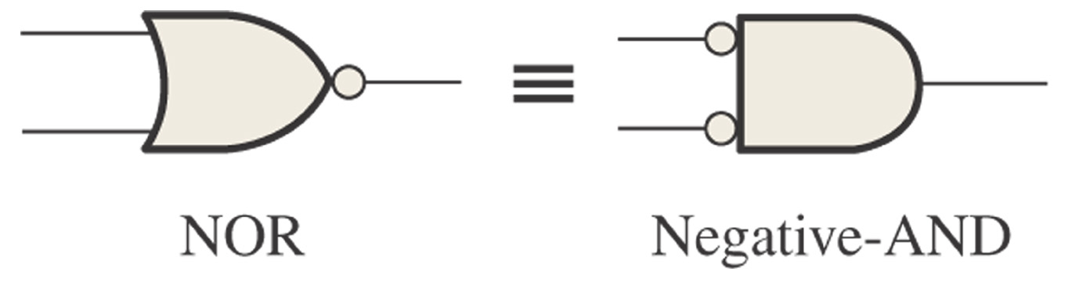
Figure 3–37
Standard symbols representing the two equivalent operations of a NOR gate.
X = A + B = A B
X = A B = A + B

Slide 37
Exclusive-OR and Exclusive-NOR Gates

Slide 38
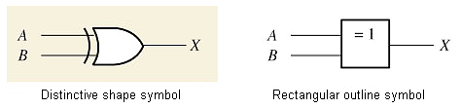

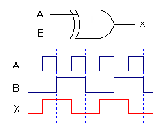
Exclusive-OR Gate
Boolean expression
Truth table
0 = LOW
1 = HIGH
Pulsed waveforms
The output of an XOR gate is HIGH whenever the two inputs are different.

Slide 39
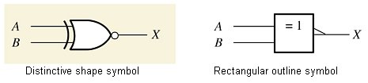

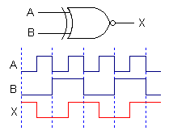
Exclusive-NOR Gate
Boolean expression
Truth table
0 = LOW
1 = HIGH
Pulsed waveforms
The output of an XNOR gate is HIGH whenever the two inputs are identical.

Slide 40
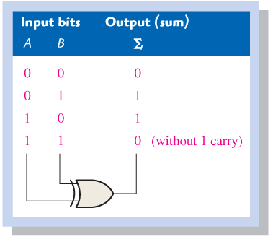
Figure 3–48 An XOR gate used to add two bits.

Slide 41







Review of Basic Logic Gates
Inverter
AND Gate
OR Gate
Exclusive-OR Gate
NAND Gate
NOR Gate
Exclusive-NOR Gate

Slide 42
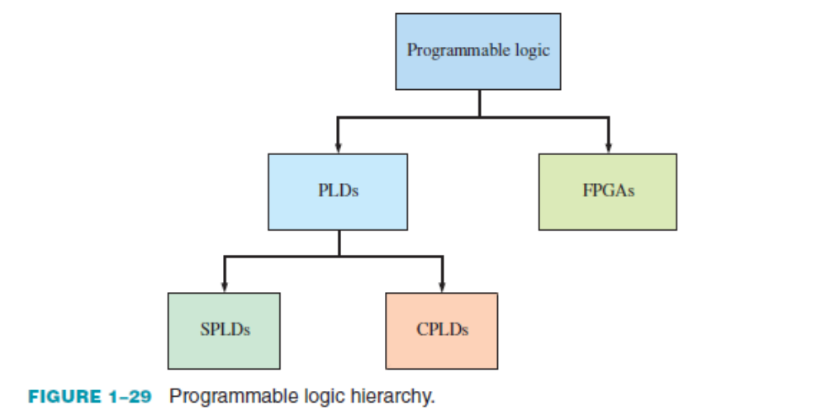
Programmable Logic
A programmable logic device (PLD) is one that does not initially have a fixed-logic function but that can be programmed to implement just about any logic design.
Category:
Two types of PLD are the SPLD and CPLD.
In addition to the PLD, the FPGA. Also, basic VHDL.
Notes:
SPLD can replace up to ten fixed-function ICs and their interconnections,
two categories: PAL and GAL
PAL (programmable array logic) is a device that can be programmed one
time. It consists of a programmable array of AND gates and a fixed array of OR gates
A GAL (generic array logic) is a device that is basically a PAL
that can be reprogrammed many times. It consists of a reprogrammable array of AND gates
and a fixed array of OR gates with programmable ouputs

Slide 43
Programmable Logic
Programmable AND array
Programmable link technology
Device programming
In-system programming (ISP)

Slide 44
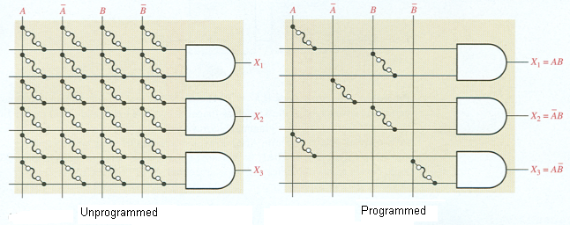
Programmable Logic
Programmable AND array
For each input, only one link is left intact.
All other connections are broken.

Slide 45
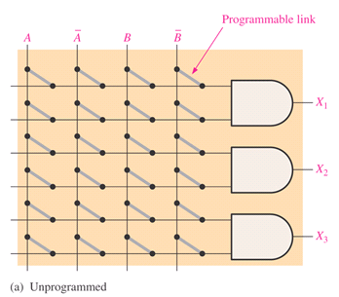
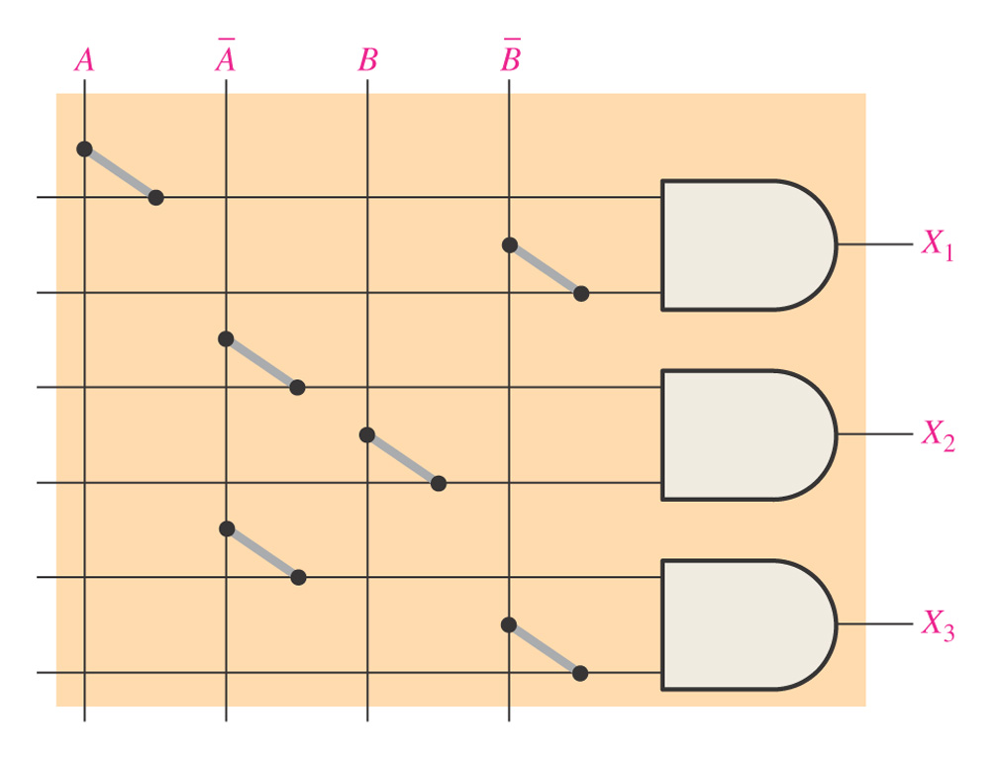
Example 3-21
Show the AND array for the following outputs:
X₁ = A B X₂ = A B X₃ = A B

Slide 46
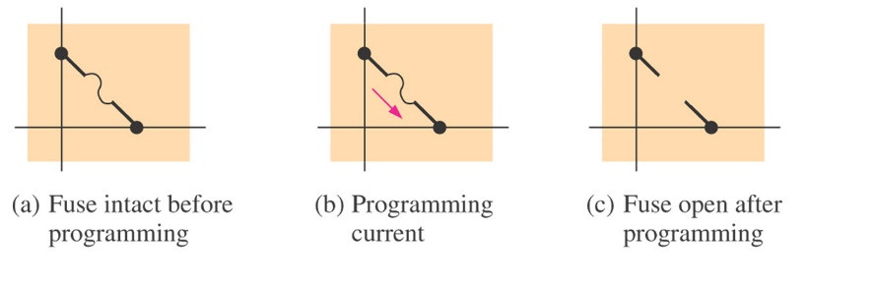
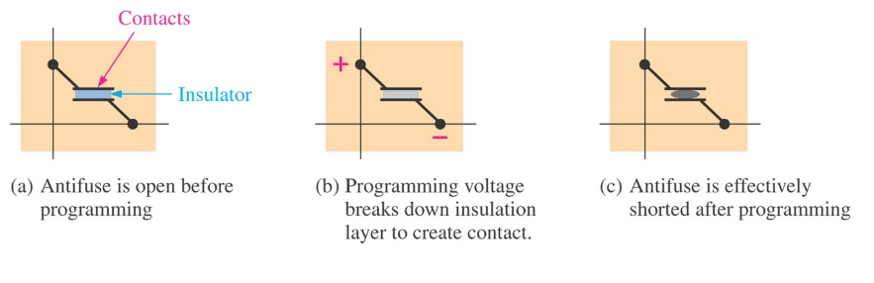
Programmable Logic
Programmable link technology
Fuse technology
Fuse is permanently open
Anti-fuse technology
Anti-fuse is permanently closed
EPROM technology
Electrically Programmable Read-Only Memories
Can be erased and reprogrammed with UV light
EEPROM technology
Electrically Erasable Programmable Read-Only Memories
In-System Programming (ISP)
Doesn’t need UV light to erase.
SRAM technology
Static Random Access Memory
Volatile – Doesn’t retain data when power is turned off

Slide 47
Fixed-Function Logic

Slide 48
Fixed-Function Logic
CMOS
  Complementary Metal-Oxide Semiconductor
TTL
  Transistor-Transistor Logic
Logic Functions operate the same in CMOS and TTL.
Different voltage, power, speed

Slide 49
CMOS
DC Voltages: 5 V, 3.3 V, 2.5 V, 1.8 V
Reducing voltage reduces power
    P =
Reducing voltage from 5 V to 3.3 V reduces power by 34%.
Prefix indicates performance.
  Prefix of 74 is commercial grade
  Prefix of 54 is military grade
  (works in more extreme temperatures)
V²
R

Slide 50
TTL
DC Voltage is 5 V
Not sensitive to electrostatic discharge.

Slide 51
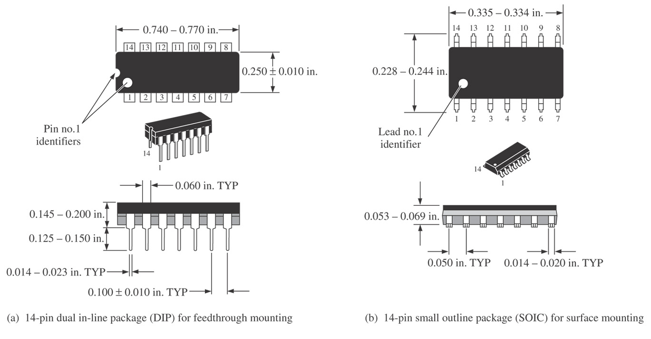
Figure 3–60 Typical dual in-line (DIP) and small-outline (SOIC) packages showing pin numbers and basic dimensions.

Slide 52
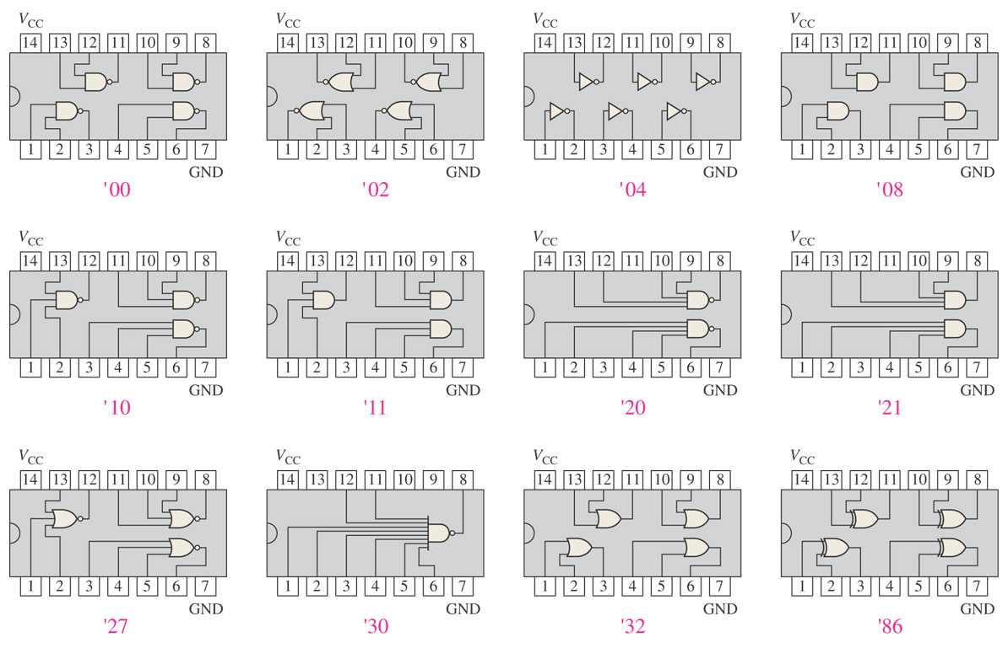
Figure 3–61 Pin configuration diagrams for some common fixed-function IC gate configurations.

Slide 53
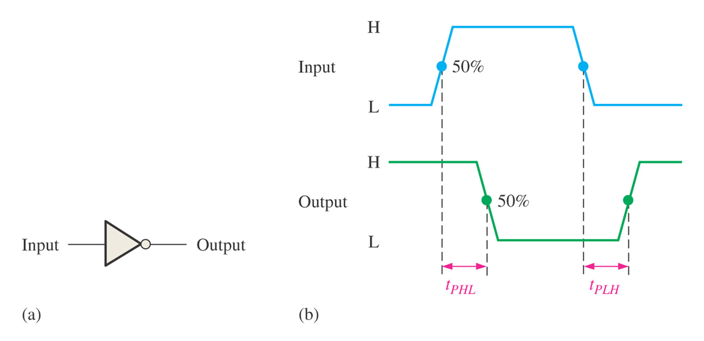
Figure 3–63 Propagation Delay

Slide 54
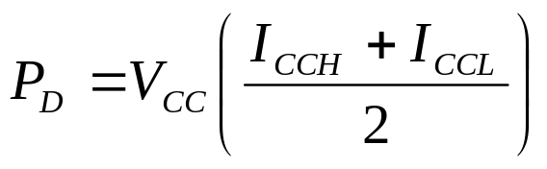
Power Dissipation
Power Dissipation, P_{D}
V_{CC} is DC supply voltage
I_{CCH} is the current when output is high
I_{CCL} is the current when output is low
Assume 50% duty cycle

Slide 55
Speed Power Product
Speed Power Product
  Used to measure the performance of logic circuits
  SPP = t_{P}P_{D}
  t_{P} is propagation delay time
  P_{D} is power dissipation in joules

Slide 56
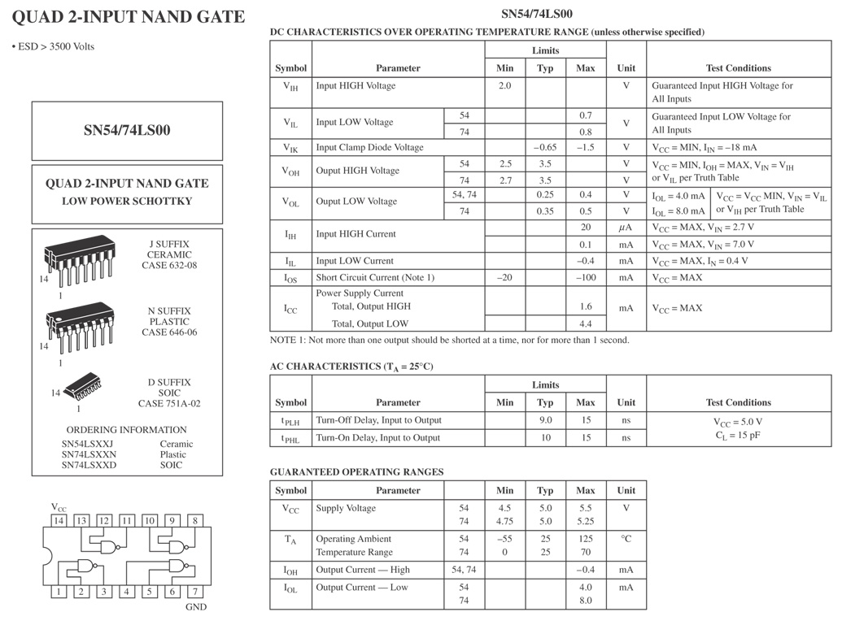
Figure 3–65 The partial data sheet for a 74LS00.

Slide 57
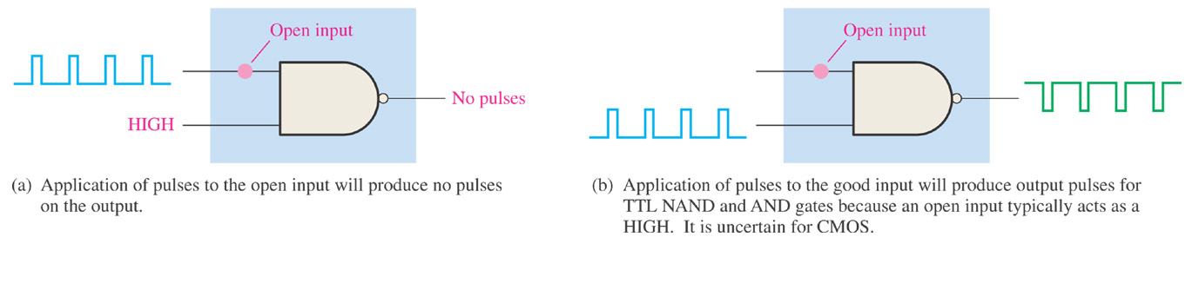
Figure 3–67
The effect of an open input on a NAND gate.

Slide 58

Troubleshooting the NAND gate.

Slide 59

Troubleshooting the NOR gate.

Slide 60

Problem 2.
If a HIGH is applied to point A, what is the logic level at points C, E, and F?

Slide 61

Review

